Slide 1

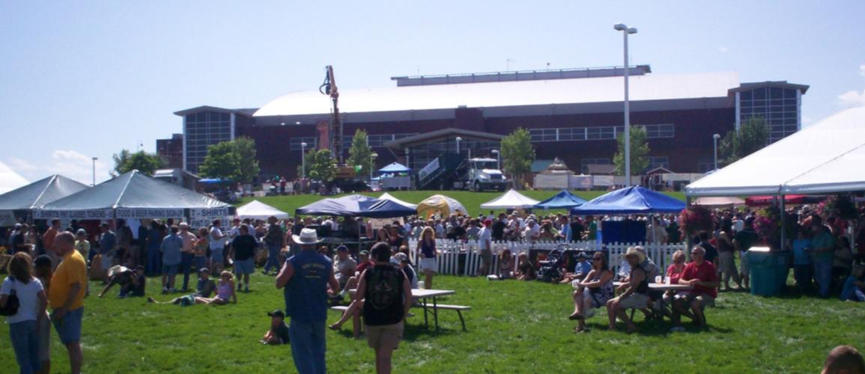


1st Annual Gnarly Barley Brew Festival
Larimer County Fair
The Ranch / Budweiser Events Center, Loveland, CO
Saturday August 1st 2009

Slide 2
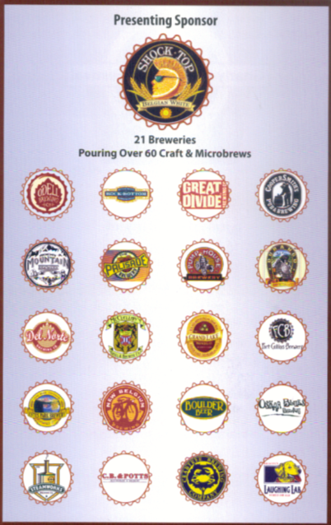
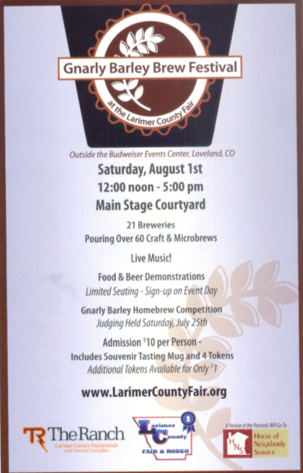
21 Breweries Represented!
Presenting Sponsor – Shock Top Belgian White

Slide 3
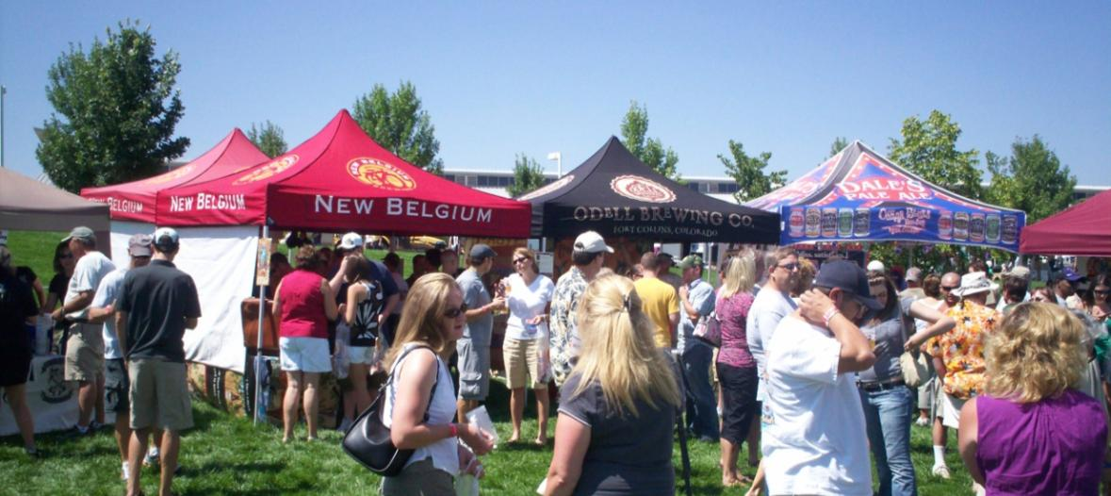
Over 60 Craft and Microbrews!
Great selection and variety of styles!
Ovations Catering and volunteers from
House of Neighborly Services, Loveland

Slide 4
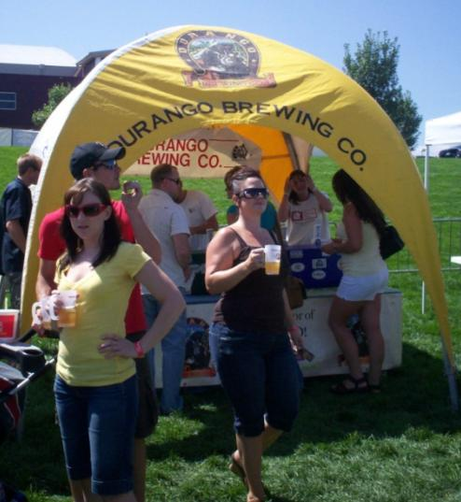
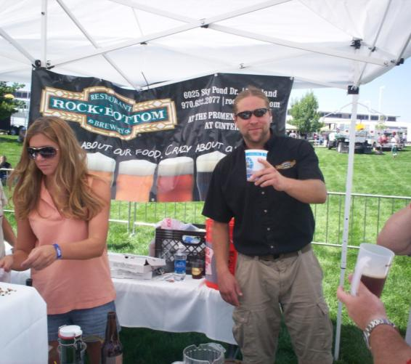
Brewing Participants from all over Colorado:
West Slope, Mountain Towns and the Front Range!
Organized and well-run; Good team work by all!

Slide 5
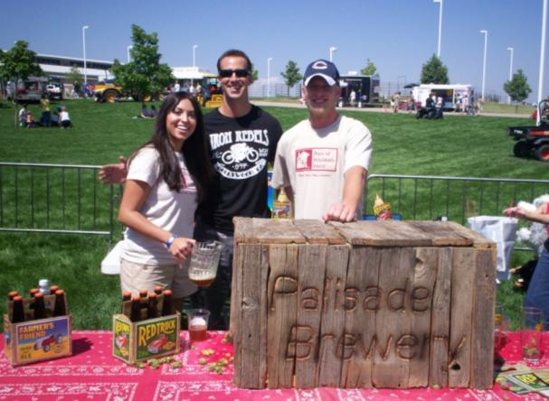
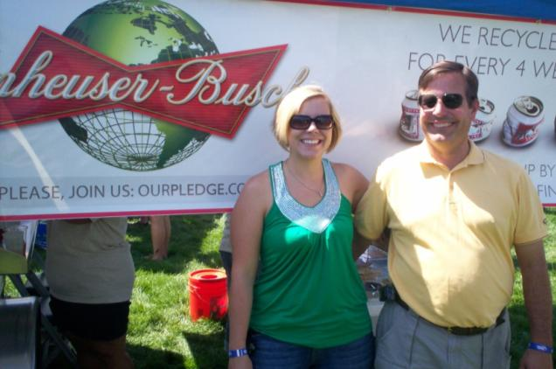
Great conditions!
Temp in the 80s! Sunny, light wind.
Perfect Colorado beer drinking weather.

Slide 6
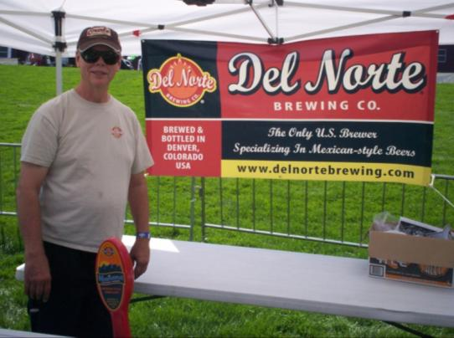
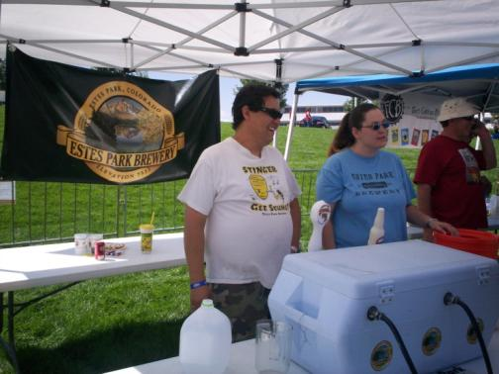
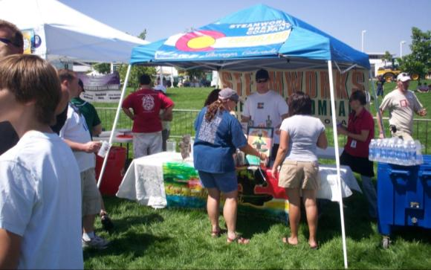
Nice locale; grassy area had a
‘Picnic in the Park Feel’.

Slide 7
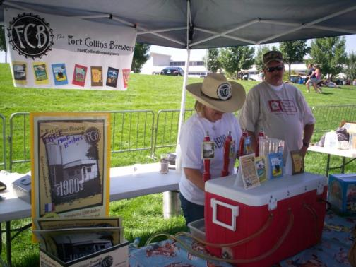
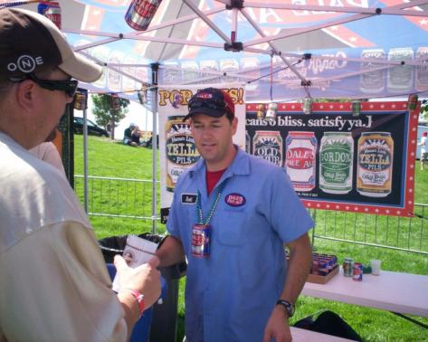
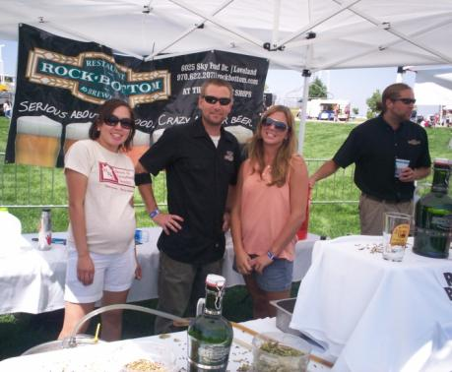
Family friendly atmosphere
with the fair and the carnival as a back-drop.

Slide 8
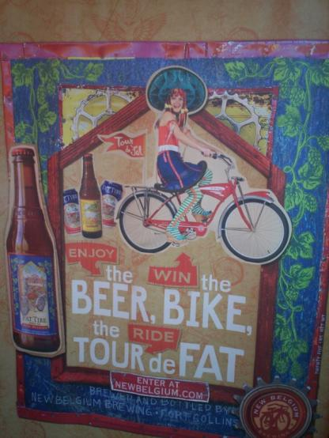
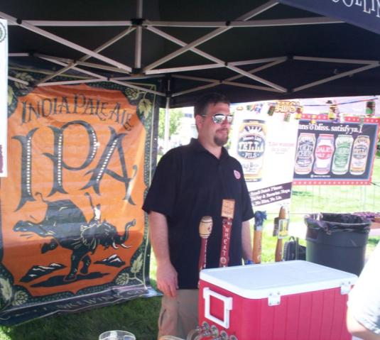
Venue gave companies a chance to do some extra advertising for their beers and upcoming events!

Slide 9
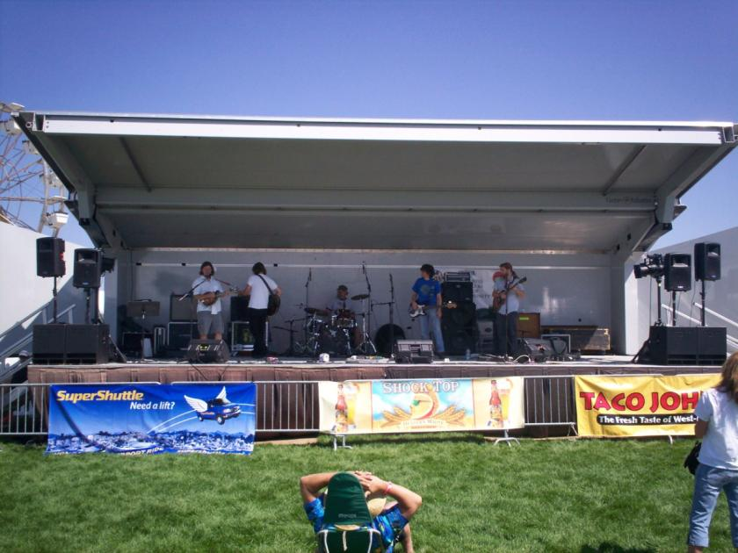
Live Music: Archie Funker, Motorhome and Northern Way!
Blue Grass, Swing and Good Old Rock and Roll!

Slide 10
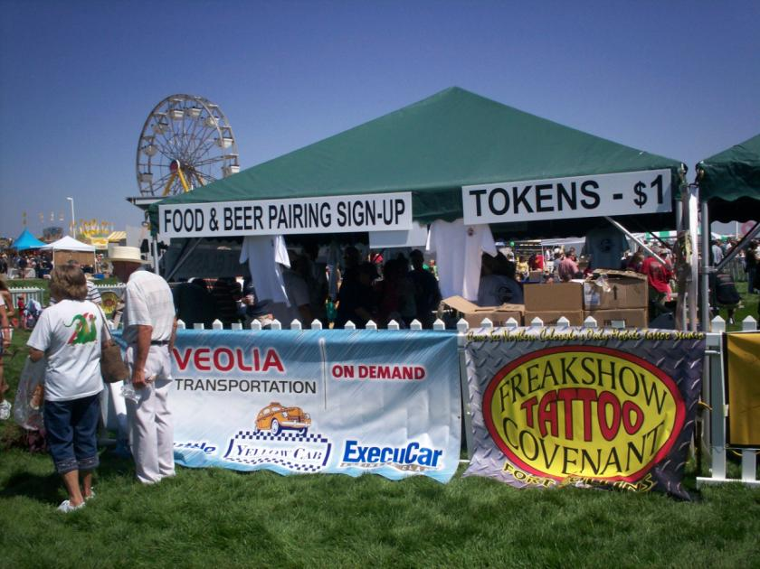
Food & beer pairing demonstrations!

Slide 11
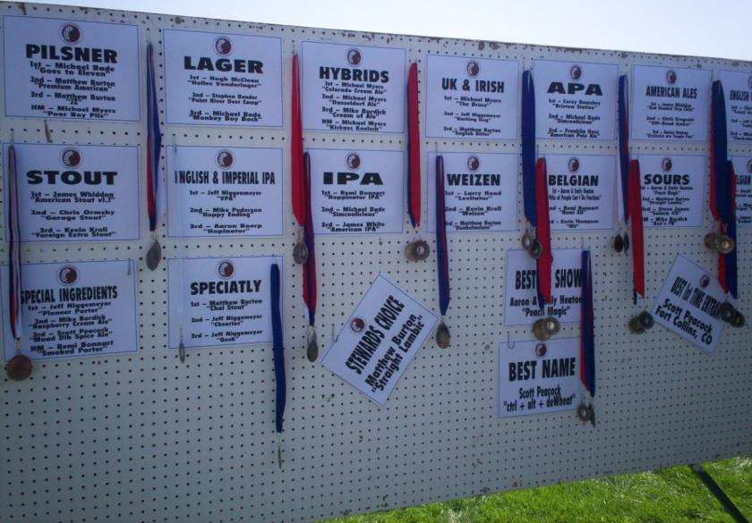
Category winners for the Gnarly Barley
Homebrew Competition
Over 20 categories. Judged on Saturday July 25th

Slide 12
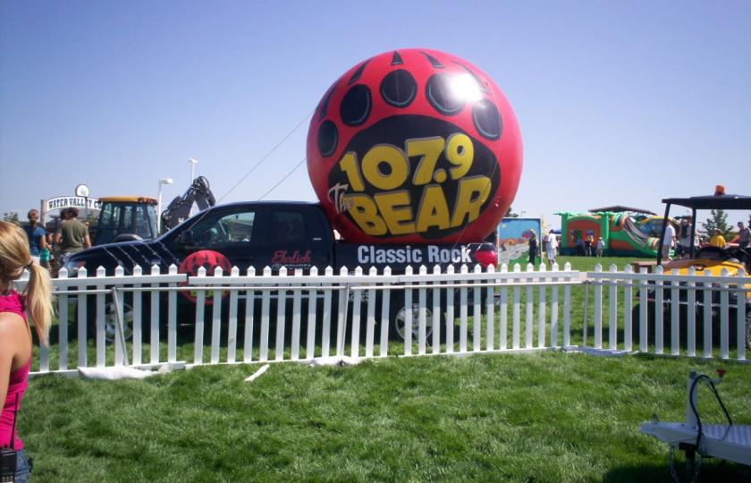
More Music Courtesy of 107.9 the BEAR

Slide 13
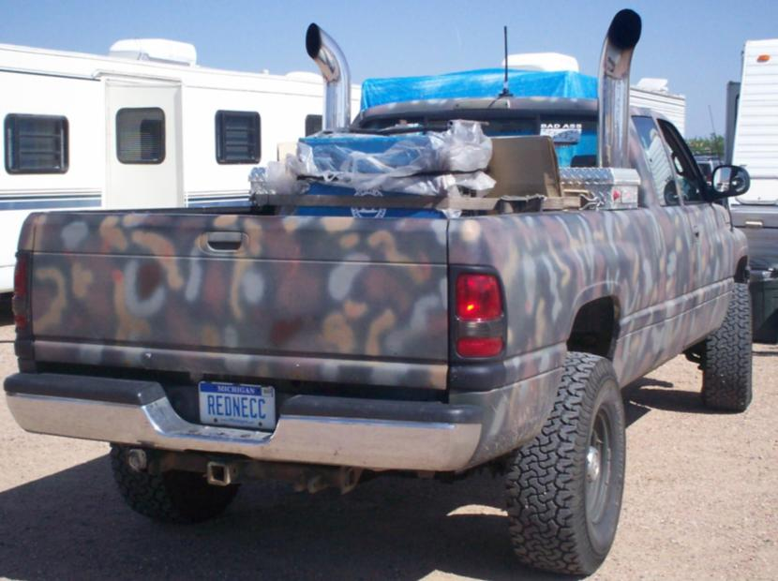
Beer fans from all over! This fan came from Michigan!
Camouflaged 4 X 4 with ‘REDNECC” Plates!

Slide 14
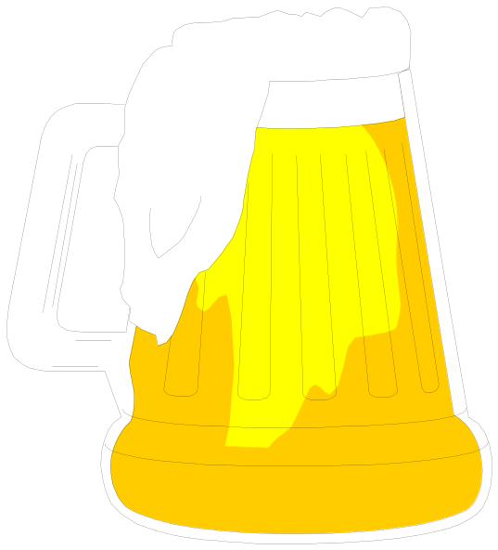
This Presentation of the
1st Annual Gnarly Barley Brewfest
Brought to you by Jim Canary
Cheers!

